Slide 1
Deep learning network training
Place scale points (SP)
75% used for model training
CT segmentations (excluding those for registration)
Combine
Cut into “vertebral triplets”
Train model Input: TRP
Targets: SP
Deep learning model
25% for model validation
Place transverse process points (TRP)

Slide 2
Scale point prediction with NN
Place TRPs
Add anchor points (SPIE work)
TRP locations
13 patient CT segmentations (for registration)
SPIE work registration points
MICCAI registration points
Deep learning model
Predict SP locations
Combine
Predicted SP locations

Slide 3
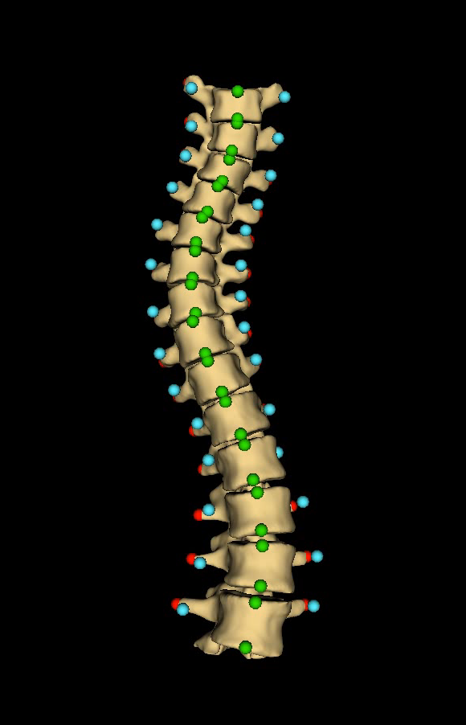
Point types
Transverse process
Anchor point
Scale point

Slide 4
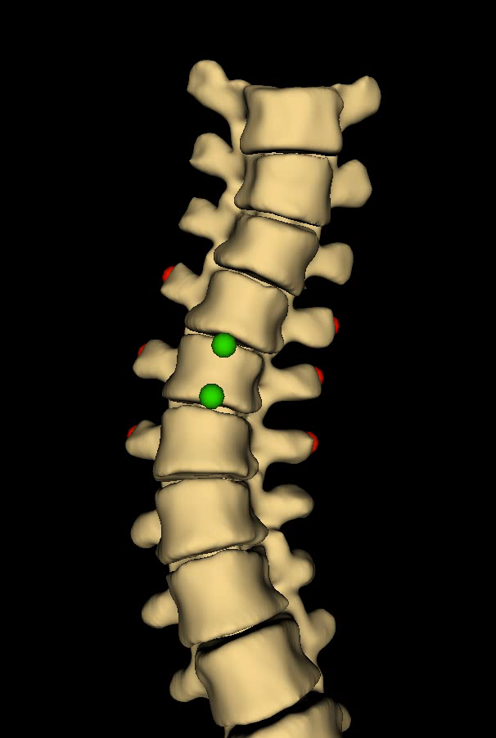
“Vertebral triplet”

